Slide 1

AI Security
Prepared by: khaled Almir
Supervisor: Dr. Natasha Alkhatib
Position: AI Red team intern at VersifAI

Slide 2
What is AI?
Artificial Intelligence (AI) is a technology that lets machines behave like humans — learning, understanding, reasoning, solving problems, making decisions.
AI enables computers or machines to perform tasks that normally require human intelligence.

Slide 3
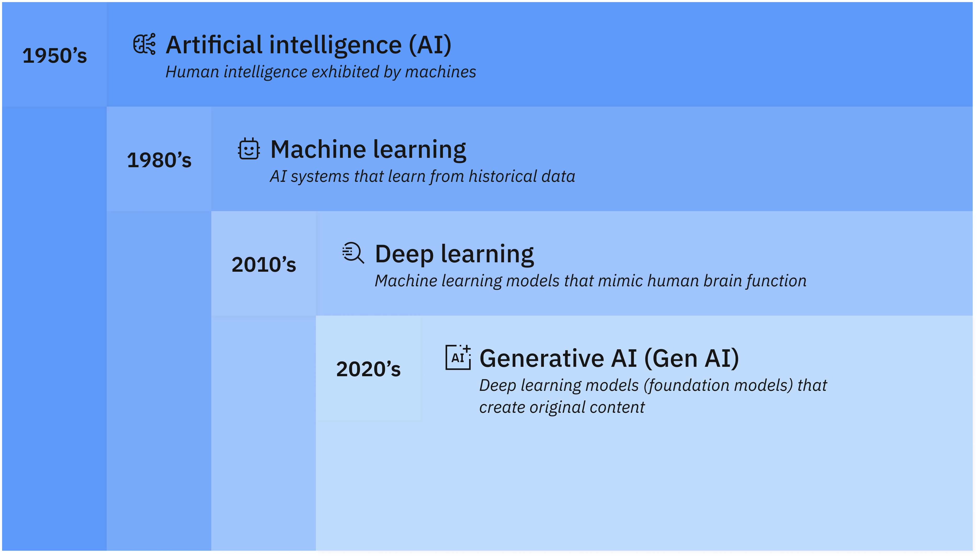
How artificial intelligence, machine learning, deep learning and generative AI are related.

Slide 4
What is Cyber Security ?
Cybersecurity is the practice of protecting people, systems, and data from cyberattacks using a mix of technologies, processes, and policies.
Why it matters at enterprise level
Cybersecurity is a core component of an organization’s overall risk management strategy.
It plays a key role in managing cyber risks such as data breaches, system compromises, and service disruptions.

Slide 5
What is AI security ?
Two Different Meanings
AI for cybersecurity
AI security

Slide 6
AI for cybersecurity
AI enhances protection of systems, networks, and data from cyberthreats.
Automates threat detection, pattern recognition, and incident response.
Uses machine learning (ML), deep learning (DL), and generative AI.

Slide 7
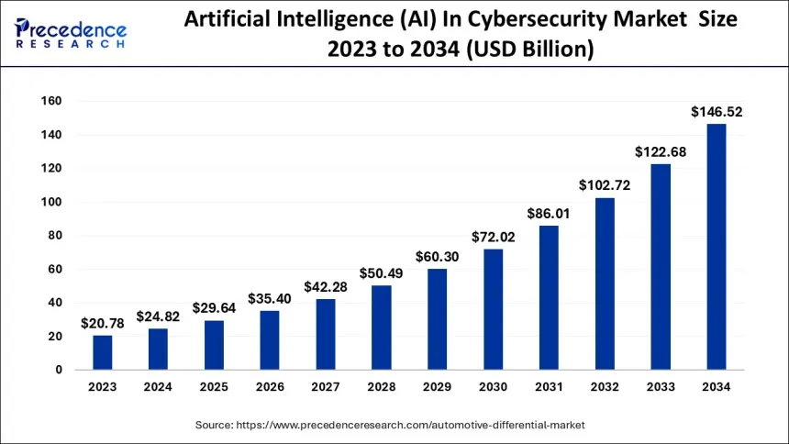
AI for cybersecurity

Slide 8
AI security
AI security is a branch of cybersecurity focused on protecting AI systems from threats and vulnerabilities.
Focuses on protecting AI systems (data, models, usage) from misuse, tampering, or unauthorized access.

Slide 9
Why AI Security Matters?
AI systems process large volumes of sensitive data (financial, medical, personal).
Vulnerabilities can lead to compromised models that produce harmful or inaccurate outputs.
Security breaches can cause downtime or loss of AI availability.
Trust and accountability are essential for AI adoption.

Slide 10
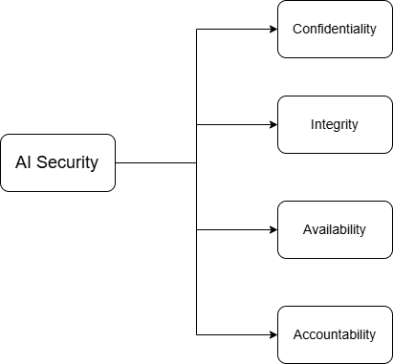
Key Concepts in AI Security

Slide 11
Best Practices for Securing AI Systems
Category | Key Practices
Data Security | • Encrypt sensitive training data • Verify data sources to avoid data poisoning • Regularly sanitize and clean data
Model Security | • Test models for adversarial vulnerabilities • Apply differential privacy to prevent data leakage • Use adversarial training to improve model resilience

Slide 12
Best Practices for Securing AI Systems
Access Control | • Implement role-based access control (RBAC) • Use multifactor authentication (MFA) • Log and monitor all access attempts
Monitoring & Auditing | • Run regular audits to identify vulnerabilities • Use automated tools for real-time anomaly detection • Update AI models frequently to patch weaknesses

Slide 13
What is AI Red Teaming?
Controlled testing of AI systems
Simulates real attackers and abusive users
Tries to:
Break safeguards
Force unsafe outputs
Finds weaknesses before attackers do
Focuses on discovery, not prevention

Slide 14
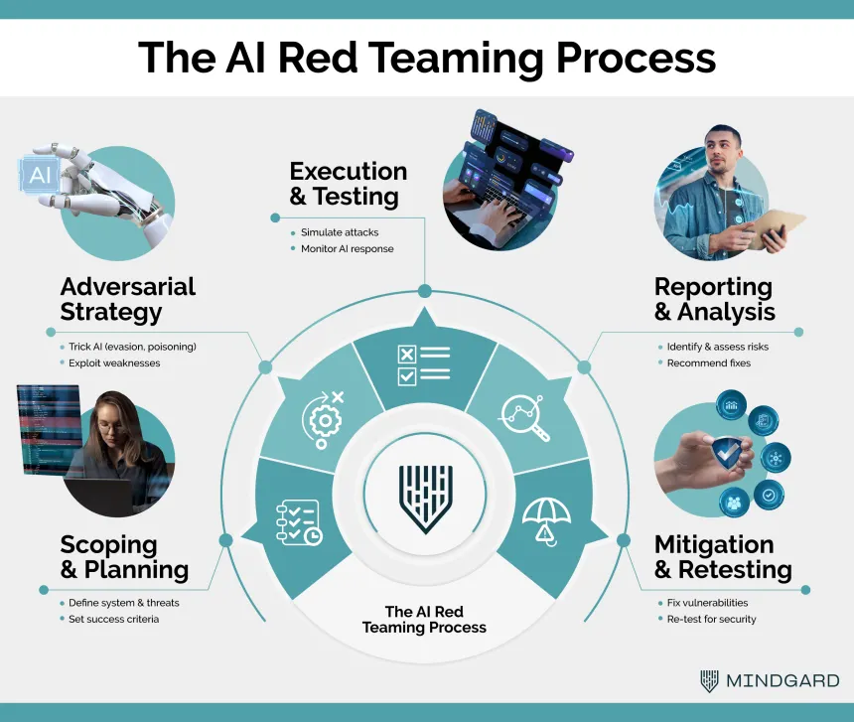
AI Red Teaming Process

Slide 15

Core Relationship between AI Security & AI Red Teaming
AI Security builds protections
AI Red Teaming tests those protections
Red teaming validates if security controls really work

Slide 16
Simple Comparison
AI Security | AI Red Teaming
Defensive | Offensive (controlled)
Prevents attacks | Simulates attacks
Ongoing process | Periodic testing
Sets protections | Tests protections
Long-term strategy | Short-term activity
Policies, controls, monitoring | Testing and probing

Slide 17
AI red teaming activity
The main activity of AI red teaming is to adversarially test AI systems to discover vulnerabilities, risks, and failure modes.

Slide 18
OWASP ML Top 10 (2023)
ML01 – Input Manipulation Attack
Attackers slightly change the input (image, text, data) to trick the model into making a wrong decision
ML02 – Data Poisoning Attack
Attackers insert bad or fake data into the training dataset so the model learns incorrect behavior
ML03 – Model Inversion Attack
Attackers query the model to extract sensitive information about the data it was trained on

Slide 19
OWASP ML Top 10 (2023)
ML04 – Membership Inference Attack
Attackers determine whether a specific person’s data was used in the model’s training set
ML05 – Model Theft
Attackers copy or recreate the model by sending many queries and analyzing the outputs
ML06 – ML Supply Chain Attacks
Attackers compromise third-party models, libraries, datasets, or tools used in building the ML system

Slide 20
OWASP ML Top 10 (2023)
ML07 – Transfer Learning Attack
Attackers manipulate pre-trained models so the fine-tuned model behaves maliciously or incorrectly
ML08 – Model Skewing
Attackers influence the model’s behavior over time by feeding biased or targeted data
ML09 – Output Integrity Attack
Attackers alter or misuse the model’s output causing wrong decisions or unsafe actions

Slide 21
OWASP ML Top 10 (2023)
ML10 – Model Poisoning
Attackers directly modify model parameters or weights to insert backdoors or hidden behavior

Slide 22
Classification of the OWASP Top 10 Machine Learning
Category | Vulnerabilities
Data Attacks | ML01: Input Manipulation Attack, ML02: Data Poisoning Attack, ML07: Transfer Learning Attack, ML10: Model Poisoning
Privacy Attacks | ML03: Model Inversion Attack, ML04: Membership Inference Attack
Model Integrity | ML05: Model Theft, ML08: Model Skewing, ML09: Output Integrity Attack
Supply Chain | ML06: ML Supply Chain Attacks

Slide 23
Top 10 vulnerability in LLM
Risk | What it Means (Simplified)
LLM01: Prompt Injection | Malicious or unexpected prompts trick the model to break rules or reveal secrets.
LLM02: Sensitive Info Disclosure | The model might leak private data, business secrets, or internal model info.
LLM03: Supply-Chain Risks | Third-party models, data, or libraries could be tampered with and compromise your system.

Slide 24
Top 10 vulnerability in LLM
Risk | What it Means (Simplified)
LLM04: Data & Model Poisoning | Bad or malicious training data can make the model biased, incorrect, or have hidden backdoors.
LLM05: Improper Output Handling | Using outputs directly (web pages, queries, code) can create attack opportunities.
LLM06: Excessive Agency | Giving the model too much power can let it perform harmful actions without human oversight.

Slide 25
Top 10 vulnerability in LLM
Risk | What it Means (Simplified)
LLM07: System Prompt Leakage | Internal instructions may leak, letting attackers bypass controls (system prompt).
LLM08: Vector & Embedding Weaknesses | Compromised embeddings or retrieval stores can inject false or harmful info (Retrieval Augmented Generation (RAG)) .
LLM09: Misinformation | The model can produce false, biased, or misleading outputs, causing real-world harm.
LLM10: Unbounded Consumption | Unlimited access can overload the system, increase costs, or let attackers extract model behavior.

Slide 26
Top 10 vulnerability in LLM
Category | Vulnerability
Input Manipulation | LLM01: Prompt Injection LLM09: Misinformation
Data & Training Risks | LLM04: Data & Model Poisoning LLM03: Supply-Chain Risks
Output & System Handling | LLM05: Improper Output Handling LLM10: Unbounded Consumption
Access & Permissions | LLM06: Excessive Agency LLM07: System Prompt Leakage
Knowledge & Retrieval Risks | LLM02: Sensitive Information Disclosure LLM08: Vector & Embedding Weaknesses

Slide 27
ChatGPT Vulnerabilities & AI Attacks (2025)
7 vulnerabilities discovered in ChatGPT (GPT‑4o & GPT‑5).
Enabled attackers to steal user data from chat history and memory.
Average impact: Data exposure, unintended AI actions.

Slide 28
Major Attack Techniques
Indirect & prompt injection: Tricks AI into executing malicious instructions.
Memory injection: Poisoning AI’s stored data.
Safety bypass: Using trusted URLs or hidden content to hide malicious prompts.
Conversation injection: Malicious instructions embedded in web content or markdown.

Slide 29
Broader AI Risks
Other AI systems also affected (Anthropic Claude, Microsoft 365 Copilot, GitHub Copilot).
Poisoned training data can backdoor AI models.
LLMs cannot reliably separate legitimate input from malicious content.

Slide 30
Takeaways
AI attacks are not just theoretical – real vulnerabilities exist.
Prompt injection and data poisoning are primary threats.
Continuous monitoring, testing, and safety controls are essential.

Slide 31
Thanks for your attention!!

